Slide 1
Alternative Turbulence Correction Methods
Some Early Thoughts
Peter Stuart
PCWG Meeting – 26 June 2015

Slide 2

Modified IEC Turbulence Correction

Slide 3
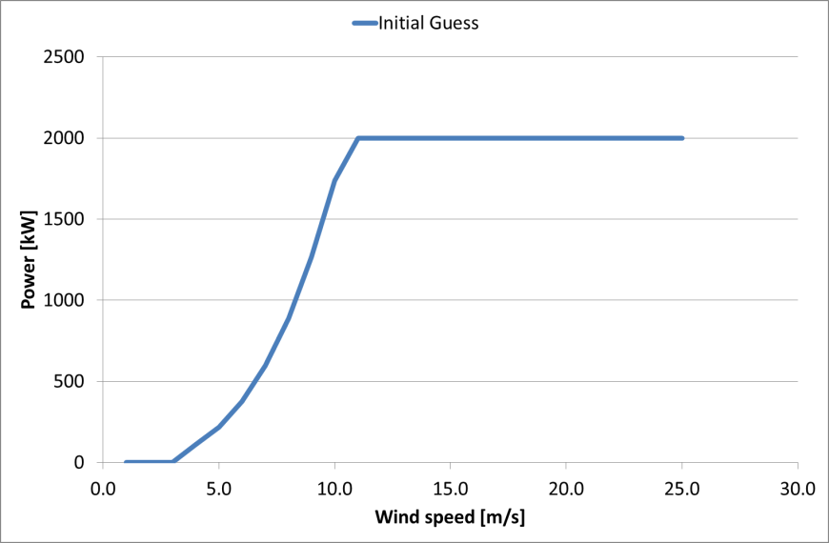
Power Curve Simulation Method
Concept: a simulation method which can generate a power curve at any required turbulence.
Note: as said previously the simulated power at a given turbulence is trusted to define a correction (from one turbulence to another), but not trusted to defined the absolute value at given turbulence.
Hypothesize: that we can define a zero turbulence power curve which gives the ‘instantaneous’ power of a wind turbine.
Zero Turb Power
Wind Speed
Illustration of instantaneous wind speed.
Turbulence Intensity = Std Dev / Mean (of instantaneous values)
Assume: the power output perfectly follows the zero turbulence power curve for each instantaneous wind speed value.
Note: we will explain later how to calculate the zero turbulence power curve.

Slide 4
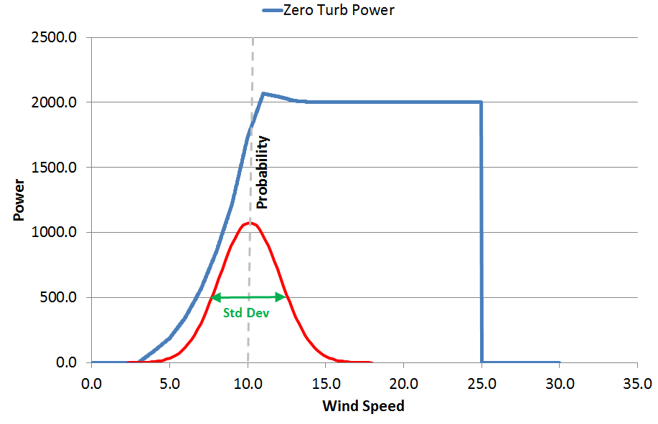
Power Curve Simulation Method
Don’t worry we haven’t explained how to derive the zero turbulence power curve yet (we’ll do this later)
Starting Point:
A zero turbulence power curve
Values of wind speed and turbulence intensity
End Point:
Simulated power at a given power curve and turbulence intensity
In place of using instantaneous wind speed values we assume that the variation of wind speed within the ten minute period is described by a normal distribution as follows:
Mean = 10-minute Wind Speed Mean
Std Dev = (10-minute Wind Speed Mean) * (10-minute Turbulence Intensity)
Zero Turbulence Power
Normal Distribution (for 10minute period)
Interpolate the zero turbulence power curve at every wind speed in the probability distribution (0 to 100m/s in 0.1m/s steps)
Take the sum product of the interpolated probability distribution and the interpolated zero turb power values:
Simulated Power
=
Σ
Zero Turb Power
×
Probability

Slide 5
Behaviour of Zero Turbulence Power Curve at the Power Curve Knee
At the power curve knee turbulence causes the 10-minute average power to fall below the zero turbulence (instantaneous) power (knee degradation)
10-minute average wind speed value
Zero Turb Power
Turbulence (variation in instantaneous wind speed)
10-minute average power value
Wind Speed
In the above illustration the 10-minute average value is exactly at the rated wind speed of the zero turbulence curve.
Therefore half of the ten minute period is at rated power and half below rated power.
Hence the ten-minute average power is less than the rated power.
Note: mathematically speaking we can say this behaviour is because the second derivative of the power curve at the knee (with respect to wind speed) is negative.

Slide 6
Behaviour of Zero Turbulence Power Curve at the Power Curve Ankle
At the power curve ankle turbulence causes the 10-minute average power to be above the zero turbulence (instantaneous) power.
Zero turbulence power
10-minute average wind speed value
Zero Turb Power
Turbulence (variation in instantaneous wind speed)
10-minute average power value
Wind Speed
The above effect is essentially the inverse of the knee behaviour.
Note: mathematically speaking we can say this behaviour is because the second derivative of the power curve at the ankle (with respect to wind speed) is positive.

Slide 7
Overview of Impact of Applying Turbulence Correction (Resource Assessment Context)
=
-
Correction
(Simulated Power at Site Turb)
(Simulated Power at Reference Turb)
High
Ankle
Knee
Positive Correction (Performance Gain)
Inflection Wind Speed
Negative Correction (Performance Degradation)
Turbulence
Reference Turbulence
Negative Correction (Performance Degradation)
Positive Correction (Performance Gain)
Low
Low
Wind Speed
High

Slide 8
IEC Turbulence Correction
The fundamental premise of the Turbulence Correction defined in the current draft of IEC61400-12-1 is that a correction can defined as follows:
P_{Target_TI} = P_{Ref_TI} + δP
δP = S_{Target_TI} - S_{Ref_TI}
where:
P is the power
S is the simulated power
For more details and worked examples of this method please visit www.pcwg.org

Slide 9
IEC Turbulence Correction > Zero Turbulence Curve
The simulated power is calculated using a ‘zero turbulence power curve’. We can express the turbulence correction as:
δP = S_{Target_TI}[Z] - S_{Ref_TI}[Z]
An initial guess is made of the zero turbulence power curve (Z_{Initial}) based upon the C_{PMax}, cut-in wind speed and rated power of the reference turbulence power curve.
The final zero turbulence power curve is then calculated by deriving a correction to take the reference turbulence power curve to the target turbulence using the initial zero turbulence power curve
Z_{Final} = P_{Ref_TI} +( S_{Target_TI}[Z_{Initial}] - S_{Ref_TI}[Z_{Initial}])
Using the functional notation (whereby square brackets denote an input function)

Slide 10
Proposed Relaxation Factor
Validation of the Turbulence Correction has both demonstrated its effectiveness and identified some shortcomings.).
One key observation is the tendency for overcorrection of the knee of the power curve in high turbulence.
The proposed modified method attempts to adjust the performance by introducing a ‘relaxation factor’:
δP = (1+a) × (S_{Target_TI}[Z] - S_{Ref_TI}[Z])

Slide 11
Relaxation Factor
δP = (1+a) × (S_{Target_TI}[Z] - S_{Ref_TI}[Z])
where a is a step function of both turbulence intensity and wind speed
a | TI | Wind Speed | Range
a₁ | TI < TI_{Lower} | U > U_{Saddle} | (High Turbulence, High Speed)
a₂ | TI > TI_{Upper} | U > U_{Saddle} | (Low Turbulence, High Speed)
a₃ | TI > TI_{Upper} | U < U_{Saddle} | (High Turbulence, Low Speed)
a₄ | TI < TI_{Lower} | U < U_{Saddle} | (Low Turbulence, Low Speed)
where a1, a2, a3 & a4 are fitted to observations.

Slide 12
Low TI ‘Empirical Extra Correction’

Slide 13
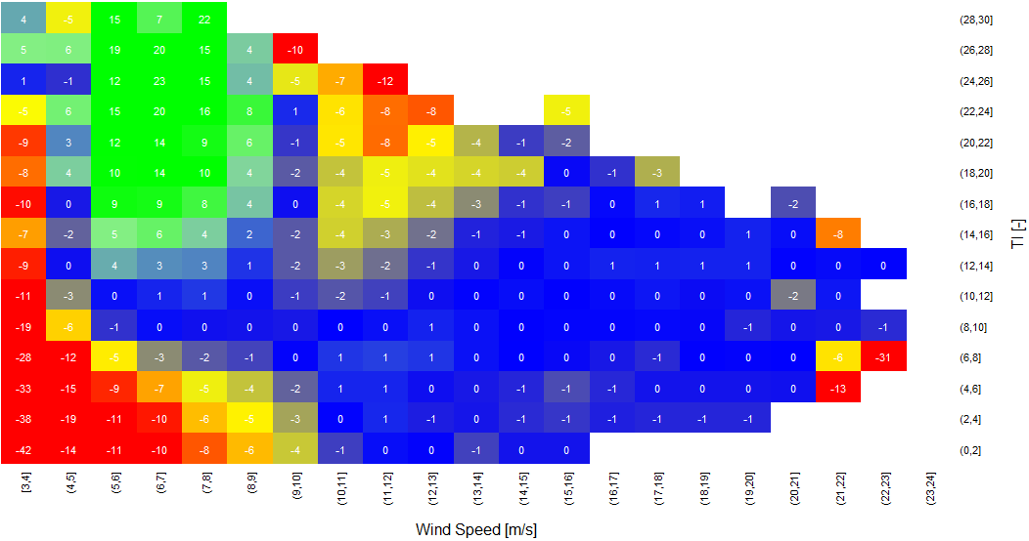

Introduction
Observed wind turbine performance
Existing correction methods (REWS and IEC Turbulence Correction) do not fully describe behaviour at low/medium wind speeds and low turbulence.
Measured Power Deviation Matrix: Deviation vs TI and Wind Speed

Slide 14
IEC Turbulence Correction
The proposed correction attempts to describe the residual correction necessary after the Rotor Equivalent wind speed (REWS) and Turbulence Correction (Renormalisation) methods have been applied.
The methodology involves the following quantities.
x’ = x_{saddle} – x
t’ = (t_{reference} – t) / t_{reference}
where:
x = windspeed
x_{saddle} = turbine saddle (inflection) wind speed i.e. somewhere between cut-in and rated.
t = site turbulence
t_{reference} = power curve reference turbulence

Slide 15
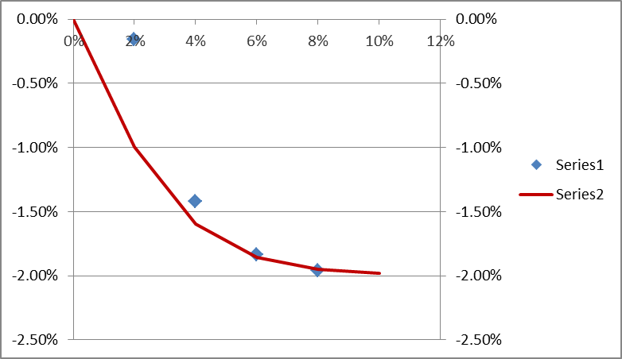
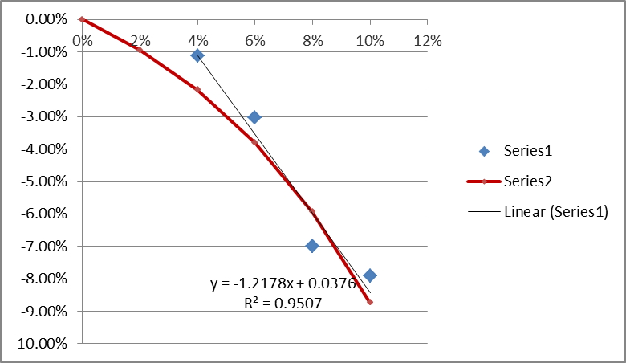
Proposed Correction
The loss is then calculated as follows:
IF x’ >0 and t’ >0
loss = A*x’ + B
ELSE
loss = 0
where:
A = -2% * tanh(2t’)
B = -3% * (e^{3/2t’}-1)
x’ = x_{saddle} – x
t’ = (t_{reference} – t) / t_{reference}
T’
Value
A vs data (fitted)
B vs data (fitted)

